Slide 1
Team 1 - VR Texting & Driving
Jake Wheeler, Nate Christiansen, Nick Kapty

Slide 2

Sponsor Information
We are sponsored by Erie Insurance
Local fortune 500 insurance company
Auto, home, life and business insurance
Source: http://www.jwolfeinsurance.com/Logos/Erie_Web.png

Slide 3
Project Overview & Background
Project sponsored by Erie Insurance
Android App
Google Cardboard VR
Created in Unity 3D game engine
Used by agents with young drivers
Purpose is to connect with young drivers
Will help young drivers recall the conversation about distracted driving they had with their agent

Slide 4
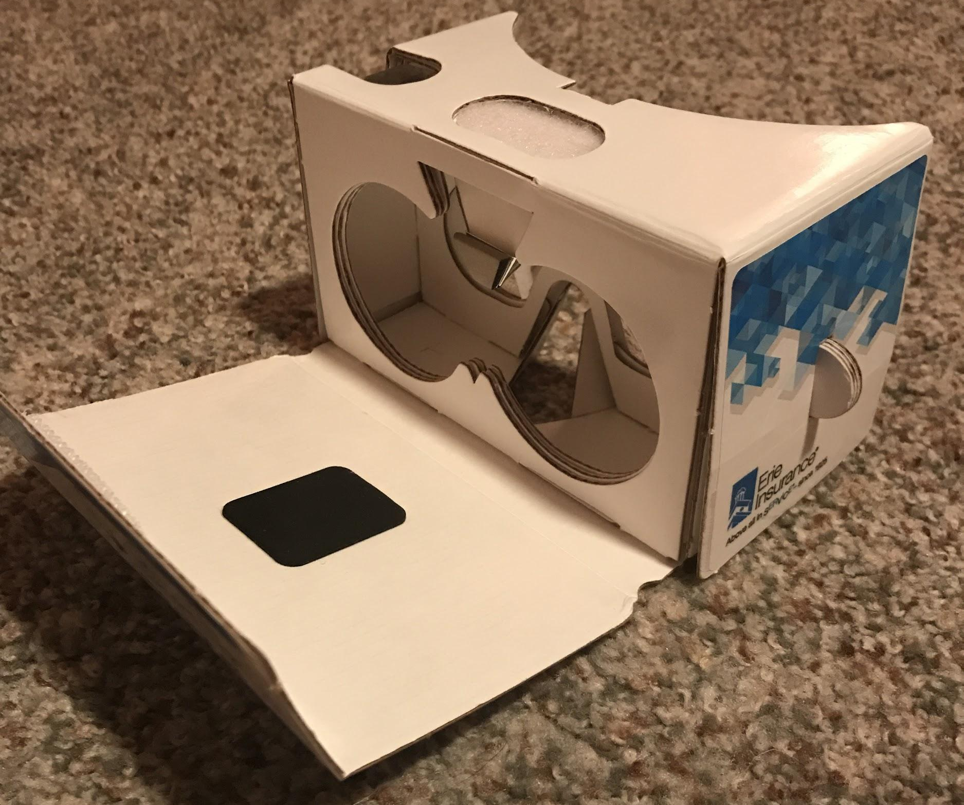
What is Google Cardboard?
Cost-effective VR
Constructed out of cardboard with lenses
Allows user to see a VR world by placing Android smartphone into device
Uses head movement, buttons, and other types of input for interaction
Google supports it with VR SDK
Google Cardboard

Slide 5

Why Unity 3D?
Erie Insurance has used Unity in the past
Uses C# as a scripting language
Intuitive interface and project structure
Compatible with Google’s VR SDK
Exports to Android with little to no code or asset modifications
Unity Asset Store (https://www.assetstore.unity3d.com/en/#!/)
Large community presence online
Source: https://unity3d.com/files/images/ogimg.jpg

Slide 6

Project Needs & Our Objective
Business sponsors looking for an engaging experience to:
Complement Erie Insurance SHIFT program
Use as a tool to help young drivers remember discussion with agent
We have created an interactive, virtual reality experience featuring:
A short tutorial
Three levels (Jungle, Lava, Space)
Each level has multiple scenarios
Each level has many point orbs to collect
Scoreboards after each level and an overall score at the end
Runs on Android, which is used by millions of people every day
Source: https://www.jointheshift.org/themes/base/images/logo-shift.svg

Slide 7
Our Requirements
The user should play as the passenger and stop the driver from texting
The system should present various scenarios that the user will help prevent by interacting with the distracted driver
The system should have points in the environment for the user to collect, allowing for more user interaction
The application should be built for the Android operating system and utilize Google Cardboard technology

Slide 8
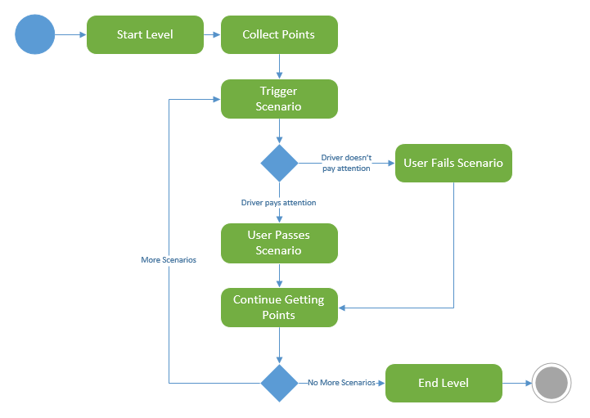
Our Design

Slide 9
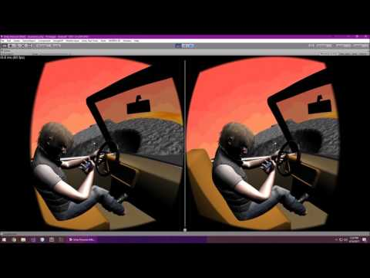
Full Video Demo of VR - Texting & Driving

Slide 10

Learned Skills During Project Development
Unity
Little to no experience when project started
Scripting, working with 3D objects, interaction between components
Utilizing Git with Unity
Teamwork
Coordination between group members
Trello
Receiving and evaluating criticism
Improving the project from feedback
Effective meetings with industry mentor and faculty adviser
Delivering a project
Working with ERIE to fulfill a need
Source: https://unity3d.com/files/images/ogimg.jpg
Source: https://pbs.twimg.com/profile_images/
552177275911671808/JiszgZdZ.png

Slide 11

Lessons Learned
Teamwork is not always easy
Different class schedules
Conflicting designs, ideas, or implementations
Allows for a better product in the end
Stick to the schedule
Allows more time to add features, test, etc.
Decreases stress
Be creative
Better product
Unique experience
Prepares us for the future
Source: capstone.bd.psu.edu
Source: http://www.jwolfeinsurance.com/Logos/Erie_Web.png

Slide 12
Questions?

